Slide 1
180° Symposium
Center for Youth Evangelism
March 25-27, 2025

Slide 2
WORSHIP

Slide 6
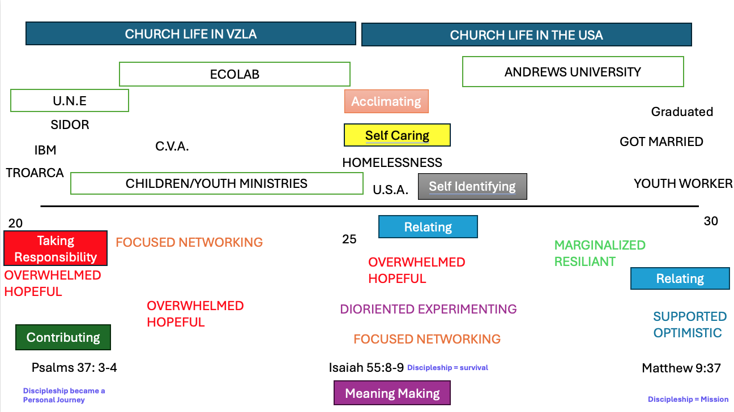

Slide 7
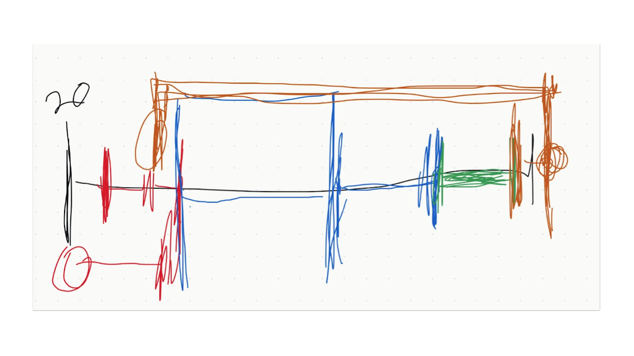

Slide 9
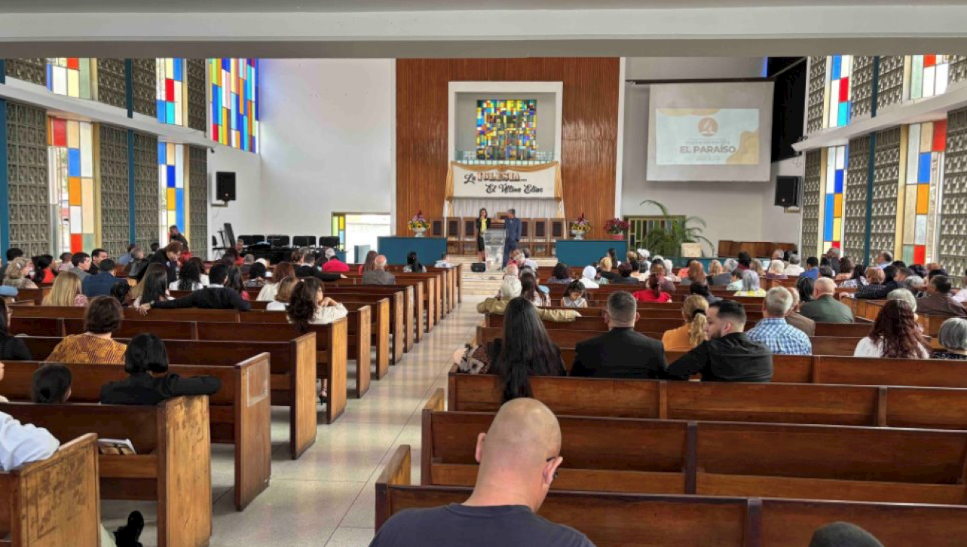

Slide 10
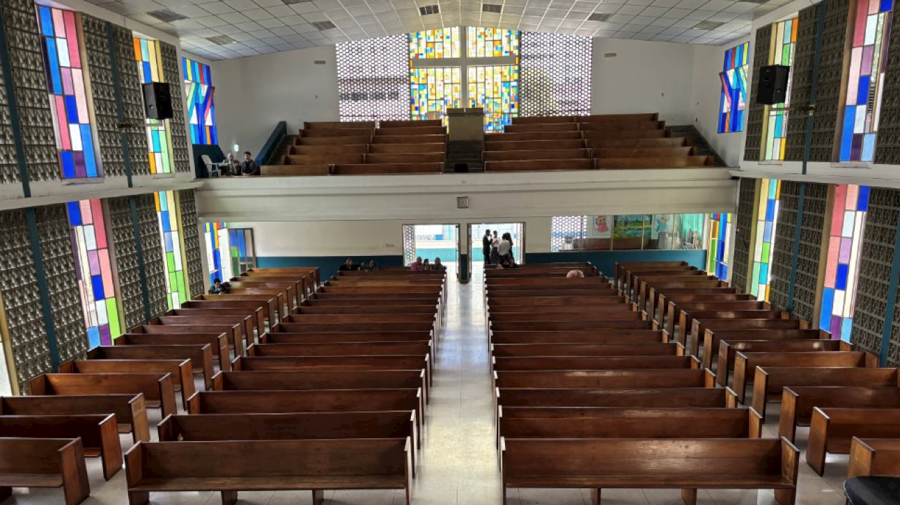

Slide 11
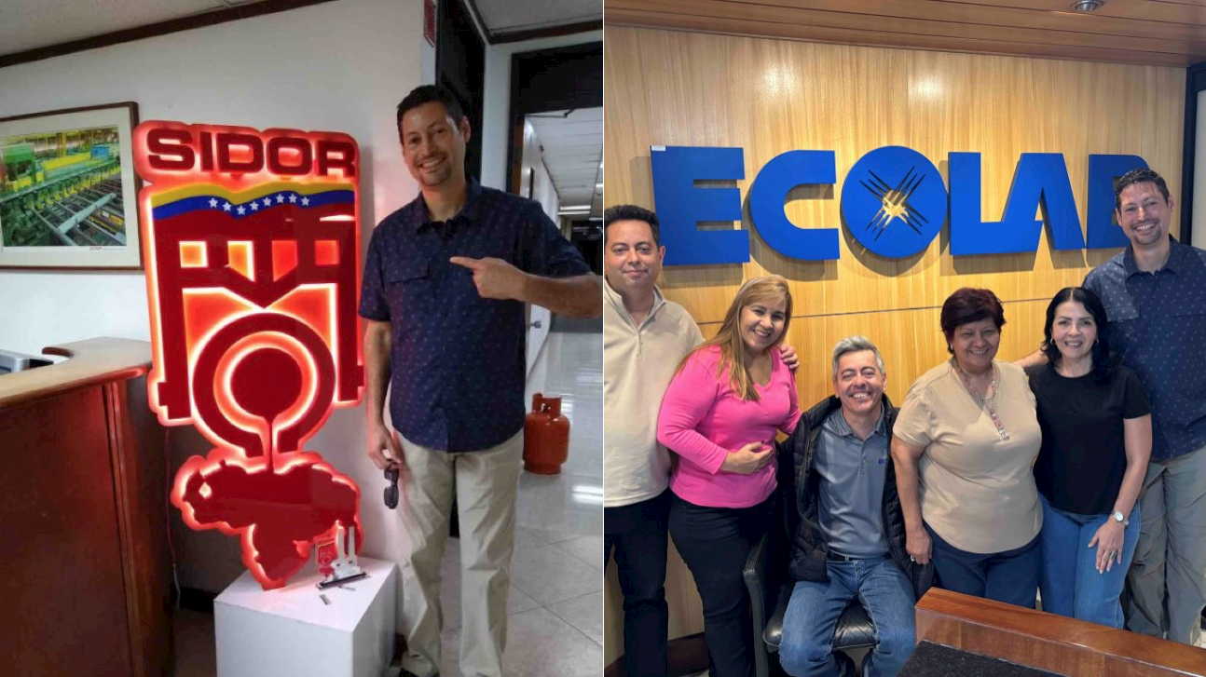

Slide 14
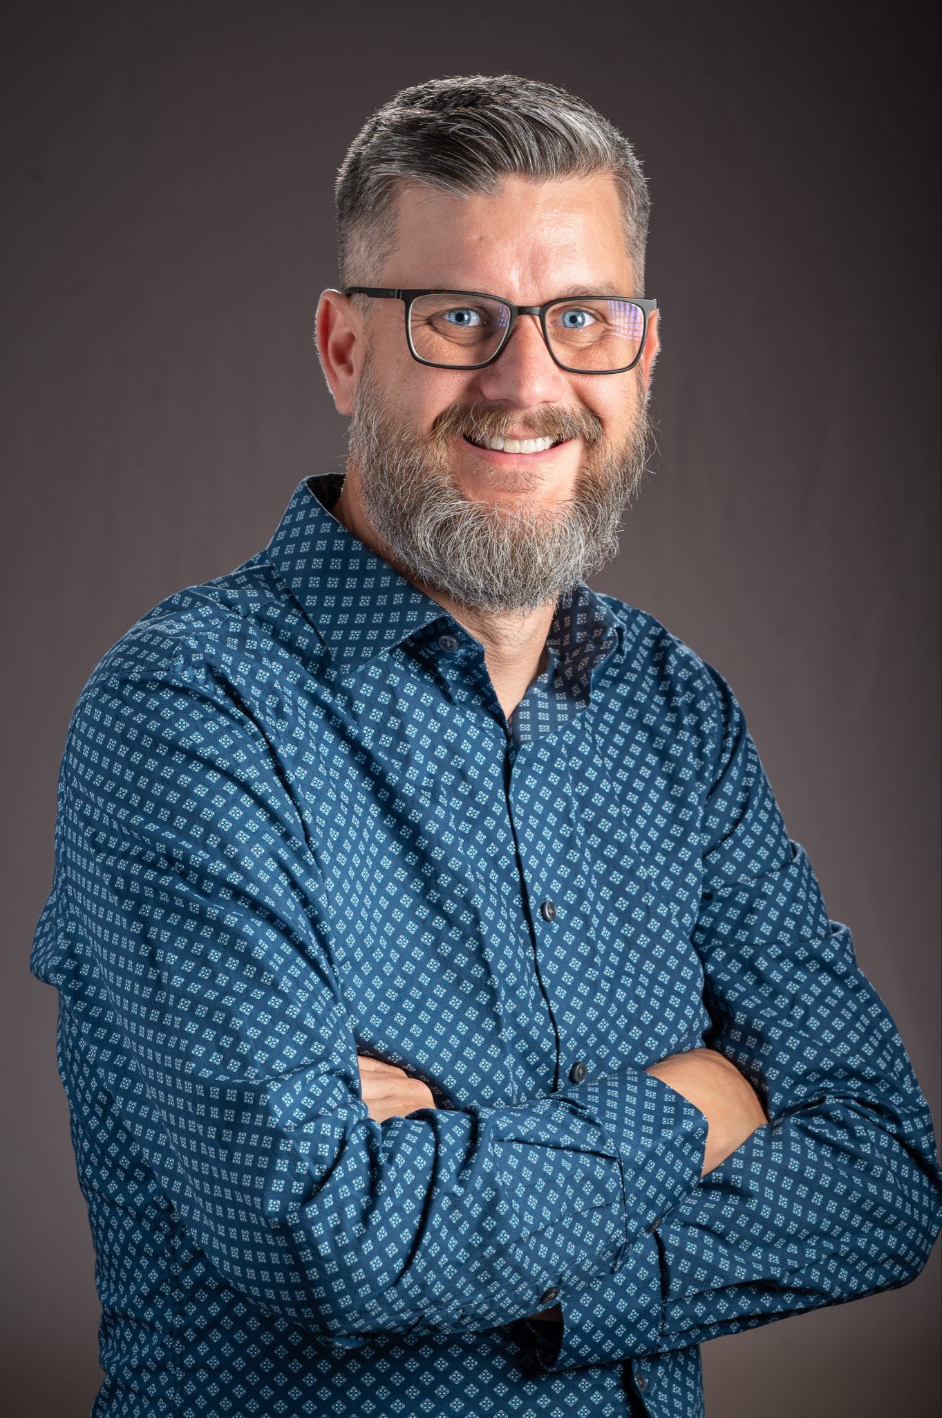
Paper #6
LET THE LITTLE CHILDREN COME TO ME: A Developmental Discipleship Model
Benjamin Martin
Notes:
Zoom

Slide 25
Paper #7
THE ROLE OF MENTORSHIP AND PEER-LED INITIATIVES IN FOSTERING SPIRITUAL GROWTH AMONG YOUTH: Insights from 1 John
Nelson Orkoh
Notes:
Zoom

Slide 39
Paper #8
UNDERSTANDING HOW EMOTIONAL INTELLIGENCE TRAINING AND AWARENESS CAN ENHANCE THE EFFECTIVENESS OF CAMPUS DISCIPLESHIP INITIATIVES
Scott Ward, Natasha Richards, and Sarah Ward
Notes:
Zoom

Slide 55
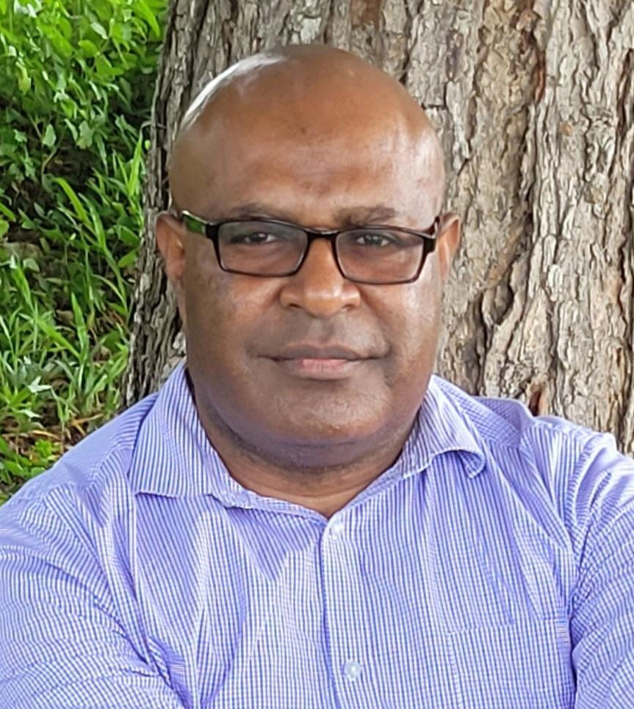
Paper #9
DISCIPLING PATHFINDERS
John Nebare
Notes:
Zoom, No Slides

Slide 56
Paper #10
DISCIPLESHIP INCLUDES BOTH ACCEPTANCE AND CHANGE
Steve Case
Notes:
Zoom

Slide 64
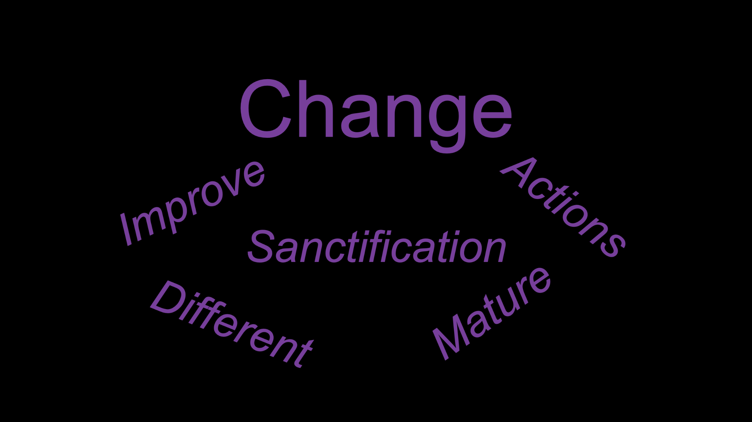

Slide 83
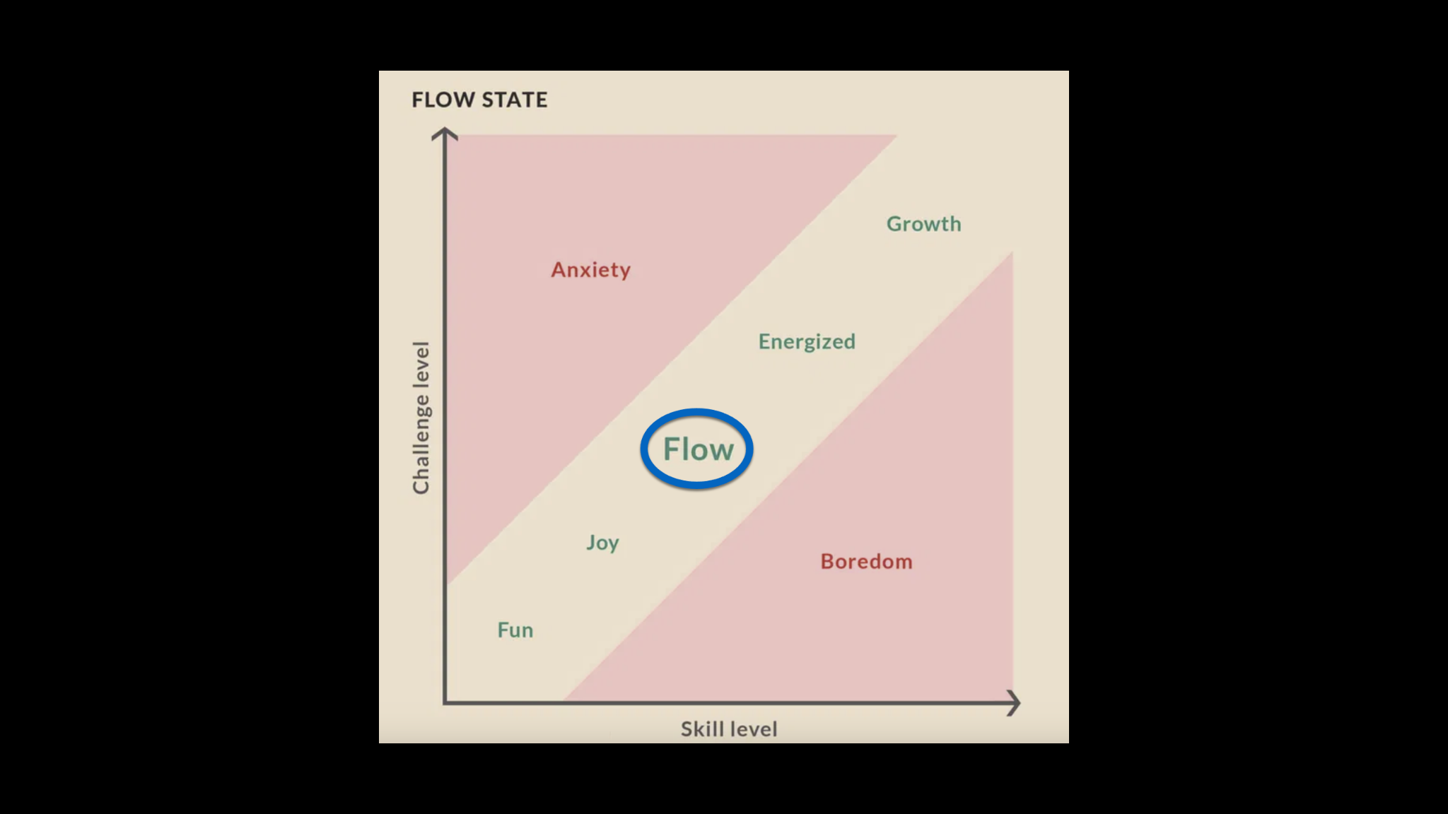

Slide 94
FOCUS GROUPS
Notes:
Zoom

