Slide 1
180° Symposium
Center for Youth Evangelism
March 25-27, 2025

Slide 2
WORSHIP

Slide 26
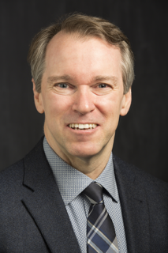
Paper #1
SEEING AND DOING: Discipleship and Moral Formation in the Gospel of John
Steve Yeagley

Slide 60
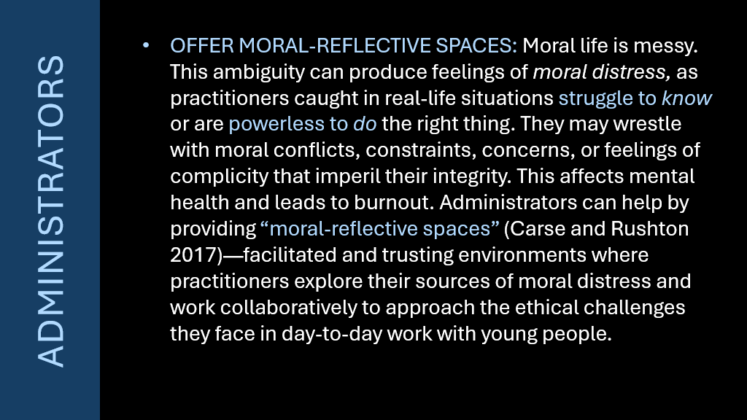

Slide 61
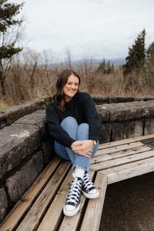
Paper #2
A CASE FOR RIGHT-TO-RIGHT BRAIN YOUTH DISCIPLESHIP
Emily Ellis

Slide 62
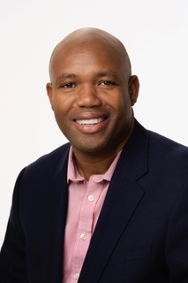
Paper #3
DISCIPLING THE YOUTH THROUGH PREACHING
Rodney Palmer
Notes:
No Slides

Slide 63
Paper #4
A DIFFERENT STARTING POINT: Youth Discipleship for a New Generation
Rogelio Paquini

Slide 78
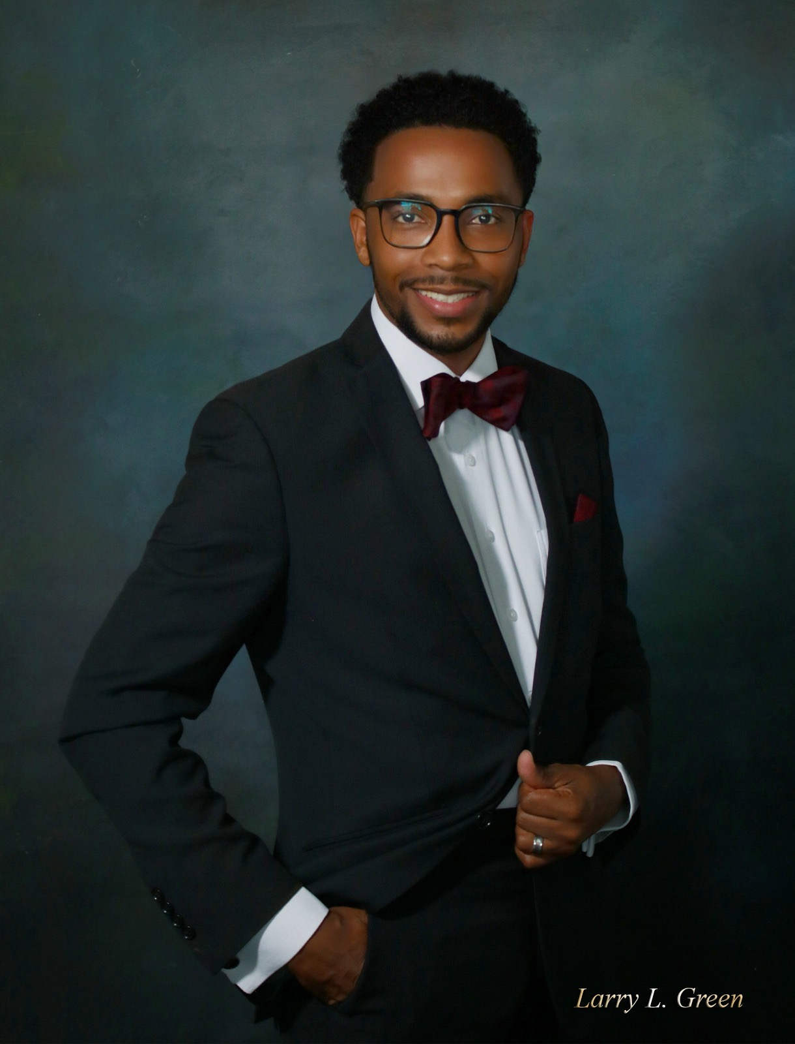
Paper #5
YOUTH IDENTITY FORMATION AND INTERGENERATIONAL MENTORSHIP
Larry Green
Notes:
Zoom

Slide 80
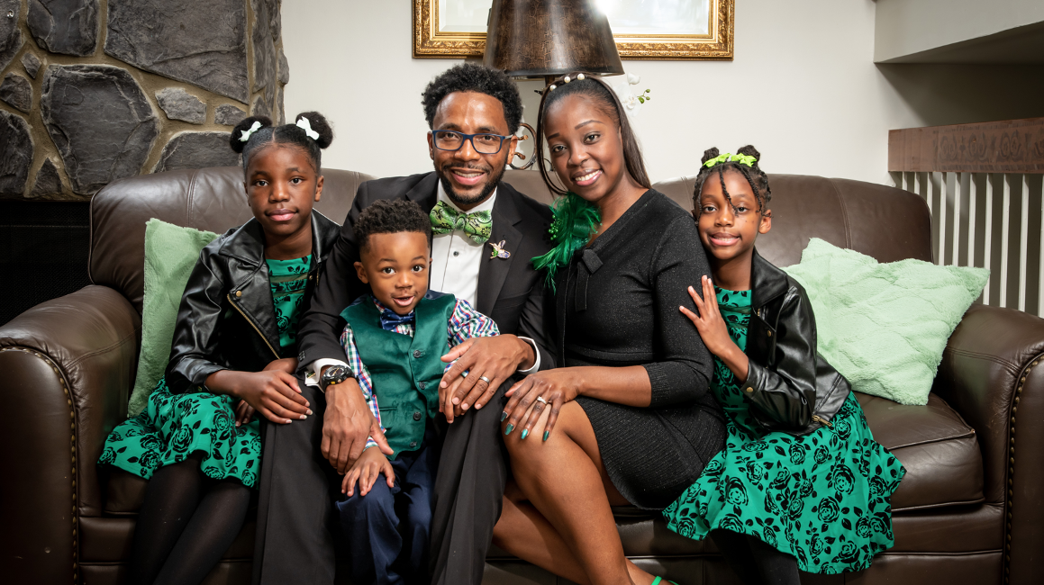

Slide 91
FOCUS GROUPS
Notes:
Zoom

